Slide 1
Lead Conversion Case Study
X Education Company

Slide 2
Problem Statement
An education company named X Education sells online courses to industry professionals.
On any given day, many professionals who are interested in the courses land on their website and browse for courses.
X Education gets a lot of leads, its lead conversion rate is very poor. X Education wants to increase conversion rate.

Slide 3
Data Collected
Given data has been collected which contains 37 features and 9240 rows.
There are few columns which are not important for the analysis and most of other features are Categorical and few are continuous.

Slide 4
Data Collected - Categorical Variables
Categorical Variables:
First converted Yes/No categorical variables to 0/1
['Do Not Email', 'Do Not Call','Search', 'Magazine', 'Newspaper Article', 'X Education Forums','Newspaper',
'Digital Advertisement','Through Recommendations','Receive More Updates About Our Courses','Update me on Supply Chain Content',
'Get updates on DM Content','I agree to pay the amount through cheque','A free copy of Mastering The Interview']
Second multiple category which are not related converted to dummy variables
['Lead Origin', 'Lead Source', 'Last Activity', 'Country','Specialization',
'How did you hear about X Education','What is your current occupation','Lead Quality','Lead Profile','City',
'Asymmetrique Activity Index','Asymmetrique Profile Index','Last Notable Activity']

Slide 5
Reduce complexity of variability
Converts those values in variables which are very less count as compared to others and its less than 10% then club them into single value as “others”
Last Notable Activity
Country
Last Activity
Lead Source

Slide 6
Outliers and Null values treatment
Checked variables for outliers and null values
For null values, impute continuous variables with mean
lead_data['TotalVisits']=lead_data['TotalVisits'].fillna(0)
lead_data['Asymmetrique Activity Score']=lead_data['Asymmetrique Activity Score'].fillna(lead_data['Asymmetrique Activity Score'].mean())
lead_data['Asymmetrique Profile Score']=lead_data['Asymmetrique Profile Score'].fillna(lead_data['Asymmetrique Profile Score'].mean())
lead_data['Page Views Per Visit']=lead_data['Page Views Per Visit'].fillna(lead_data['Page Views Per Visit'].mean())

Slide 7
Model Creation
Split the dataset into train test
Created model using statsModel
Created heat map and drop highly correlated variables
['Receive More Updates About Our Courses','Update me on Supply Chain Content','Get updates on DM Content'
,'I agree to pay the amount through cheque','Magazine']
Iterated model using p-value and VIF using top to down approach.
Created model using statsModel API and SKlearn

Slide 8
Accuracy Matrix
Accuracy Score is 85.46% using statsModel
Accuracy Score is 85.89% using SKlearn
Sensitivity / specificity
0.8009132420091324 / 0.8896839594514013
Recall / precision
0.7830494728304948 / 0.8355690177412376
Confusion_matrix
[[1492, 185],
[ 218, 877]])

Slide 9
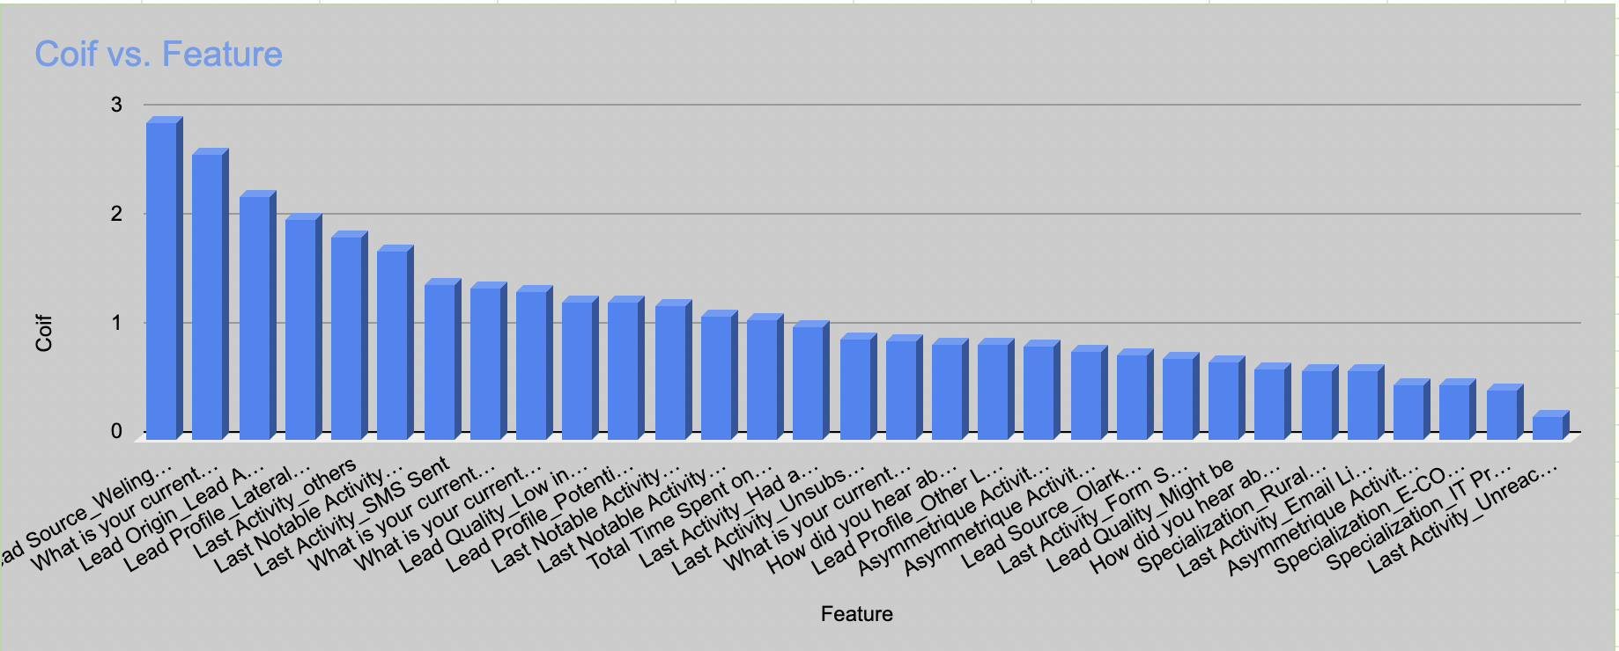
Top Features
Top 3 features are :
What is your current occupation_Working
Lead Origin
Lead Source
Features which are not contributing to conversion.
Newspaper Article
X Education Forums
Newspaper
Do Not Call

